Slide 1

World Council for Curriculum and Instruction International
Partnership between
The Global City Innovative College (Philippines) and The National Kaohsiung Normal University (Taiwan) in the Student Practice Teaching Program for Future Global Educators,
February 14- March 15, 2011
Dr. Teresita P.Pedrajas
Program Chair
School of Education
Global City Innovative College

Slide 2


Slide 3

STATEMENT OF THE PROBLEMS
1. What stages were undertaken to establish the partnership in forming the future global educators between the Faculty of Education of National Kaohsiung Normal University in Taiwan and the Global City Innovative College in Taguig City, Philippines?

Slide 4
2. How were the following areas/ components of the Student Teaching Program attended to by both institutions?
a. Approval from the administration
b. Consultation and Approval from the parents
c. Profile of student teachers
d. Preparation for One month Student Practice Teaching Program
e. Data on the Board and lodging of students, payment, security
f. Amount to be paid for mentoring

Slide 5
STATEMENT OF THE PROBLEMS
g. Preparation for visa & round trip ticket
h. Responsibilities of GCIC and NKNU
Schedule of activities
j. Orientation to the Rationale, objectives and expectations
k. Regular feedback /update of the student- teaching program
l. Evaluation of the program

Slide 6
3. To what extent have the student teachers involved in the Practice Teaching learned about the following:
culture of the school community
characteristics of teachers
characteristics of students
support of parents
program of instruction

Slide 7
STATEMENT OF THE PROBLEMS
methods, approaches and strategies of teaching- learning
preparation and use of instructional materials,aids
Integration of values
assessment of learning experiences

Slide 8
4. To what degree have the student teachers demonstrated the following during their student Practice Teaching Program?
a. Self-confidence
b. Communication skills in English: listening, reading, speaking and writing
c. Planned their lesson plans
d. Employed variety of teaching-learning strategies
e. Prepared Instructional materials
f. Used instructional materials

Slide 9
STATEMENT OF THE PROBLEMS
g. Honed their multiple intelligences
h. Demonstrated their life- long skills and competences
i. Integration of values
Evaluated the learning experiences
Preparation of Comprehensive Student Teaching Portfolios

Slide 10

Fourth Year Student Teachers
S.Y. 2010-2011
Bachelor in Elementary, Major in Early Childhood Education
Samantha Marie B. Esperanza
Carla May D. dela Cruz
Angelica Naval

Slide 11
Bachelor in Elementary,
Major in Special Education
Vanessa B. Hipolito
Jousel Ann T. Apelo
Kimberly Ann B. Labastida
Lora L. Callanga
Ginalyn N. Taga-an
Leona Paola C. Vinluan
Bachelor in Secondary,
Major in English as a Second Language

Slide 12
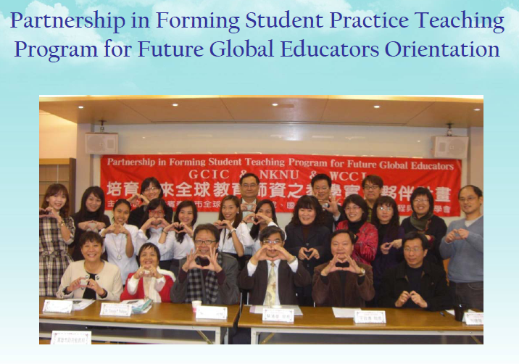

Slide 13
Well conceptualized Welcome Orientation Program to the whole group organized by
Dr. Vincent Shieh
with no less than the Commissioner of Kaohsiung Bureau of Education delivering his Inspirational Message.
A well presented Itinerary Kit for the GCIC student teachers with complete one month schedules, addresses, road maps of the four schools, transportation facilities, parks, cultural and business centers, dormitory, etc to assist them in their travels and direction.

Slide 14
Big Tarpaulin
The hospitality of the whole National Kaohsiung Normal University leadership accorded to the Filipinos from Day One to Day Thirty.
The sumptuous food served during Day One.
The school heads, cooperating mentors gave a local orientation program to the assigned student teachers on Day One.

Slide 15
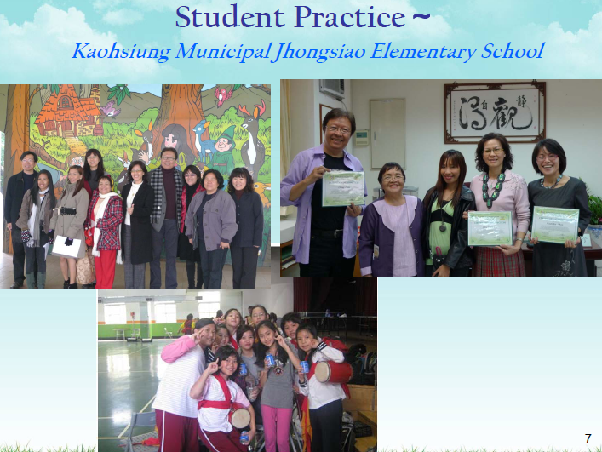

Slide 16
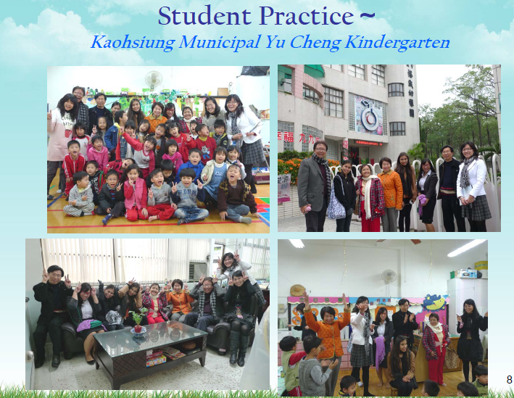

Slide 17
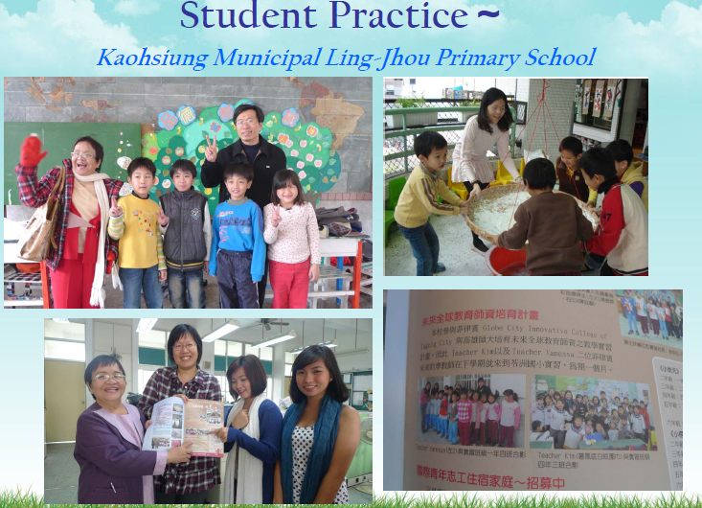

Slide 18
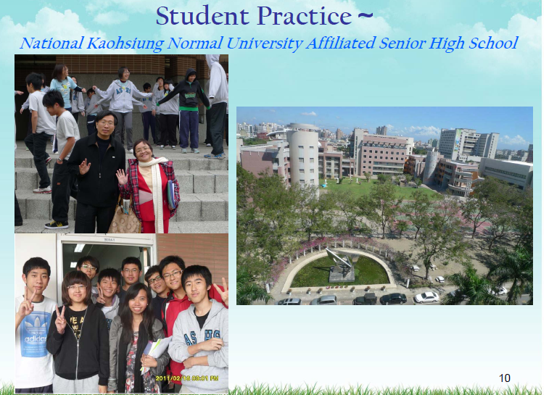

Slide 19
Stages of Planning
May 28-29 ,2009 Conceptualization Stage
World Council for Curriculum and Instruction International Executive Board Meeting in Puerto Princessa City, Palawan ,Philippines where the possible partnership between Global City Innovative College of Taguig City, Philippines and the National Kaohsiung Normal University in Kaohsiung, Taiwan was approved in Principle.

Slide 20
Stages of Planning
March 15, 2010
Dr. Teresita P. Pedrajas, School of Education, Global City Innovative College on the Philippines reminded Dr. Vincent Shieh of National Kaohsiung Normal University about the possible partnership for forming future global educators.

Slide 21
Stages of Planning
March 20,2010 :Communication with students
Dr. Teresita P. Pedrajas mentioned the plan to the GCIC fourth year students for possible student practice teaching program which was positively accepted.

Slide 22
Stages of Planning
March 16, 2010: Acceptance of Proposal
Dr.Vincent Shieh , the WCCI International President accepted the partnership and mentioned that a meeting with Dr. Der-Long Fang, Dean of the College of Education of National Kaohsiung Normal University of Taiwan will be present during the International Conference for Educators in the University of Pecs, Hungary whom Dr. Pedrajas could personally discuss the MOA.

Slide 23
Stages of Planning
May 3,2010
Dr. Teresita P. Pedrajas reiterated to the WCCI Executive Board and the International Secretariat about this partnership which was overwhelmingly endorsed.

Slide 24
Stages of Planning
June, 2010 Approval by GCIC administration
Presentation of the possible partnership for Student Teaching Program to the GCIC President, Vice President for Academic Affairs and Vice President for Administration for their approval .

Slide 25
Stages of Planning
July 5-10,2010
Preparation of Memorandum of Agreement for the partnership with National Kaohsiung Normal University in Taiwan, shown to the GCIC President, VPAA and the VPA for their approval

Slide 26
MOA
July 11-17, 2010 :Acceptance of MOA
Preparation of Memorandum of Agreement shown to Dr. Fang, Dean of Education of National Kaohsiung Normal University of Taiwan. Approved in Principle the Student Teaching Research partnership with the GCIC during the WCCI International Conference in Pecs, Hungary

Slide 27
Preparatory Stages : August-December, 2010
Preparation of Budget : Travel, dormitory, allowances
Consultation with parents for support
Preparation of Passports/visa papers
Preparation for the One Month Practice Teaching in NKNU, Kaoshiung, Taiwan
Purchase of tickets December,2010
Travel Arrangements February, 2011

Slide 28
Observations
1. Culture of the school community:
the student teachers are all amazed at the structure of these public schools which were well built in very spacious lands, student friendly
Centralized and fully furnished
Clean, well maintained, comfortable and spacious classrooms with white boards, computers, LCD, automatic screens, and telephones, lots of books, educational toys

Slide 29
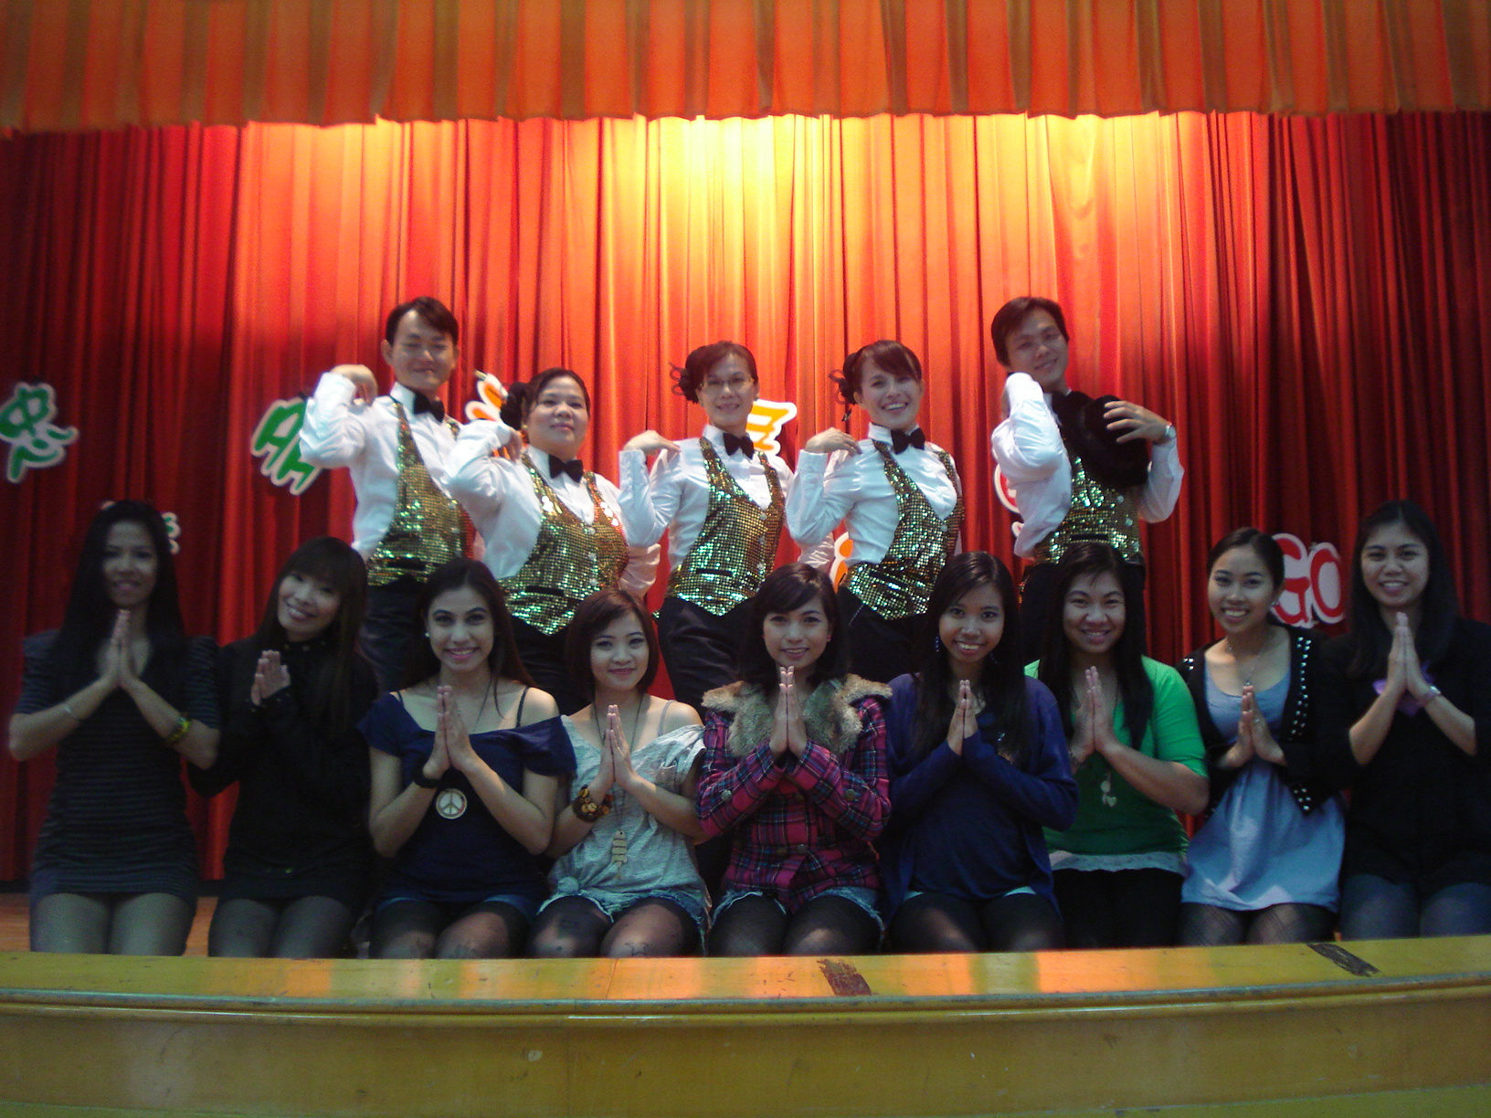
Performance at Jhong Siao

Slide 30
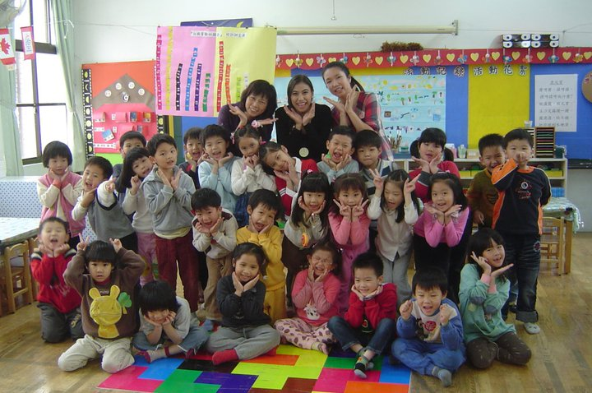
Sam with her cooperating teachers and her students

Slide 31
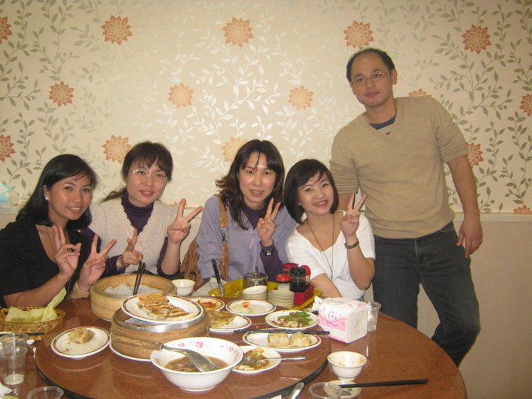
SPED at Ling Jhou

Slide 32
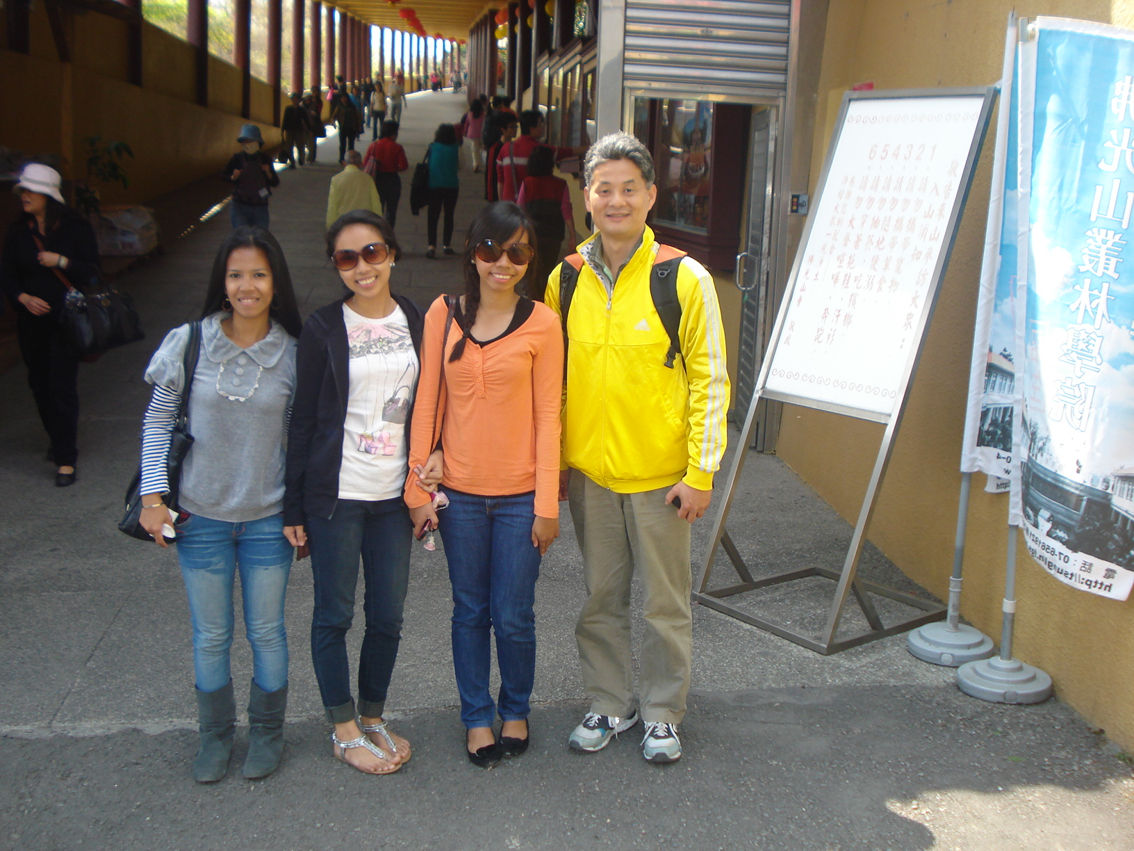
Fo Guang Shan field trip

Slide 33
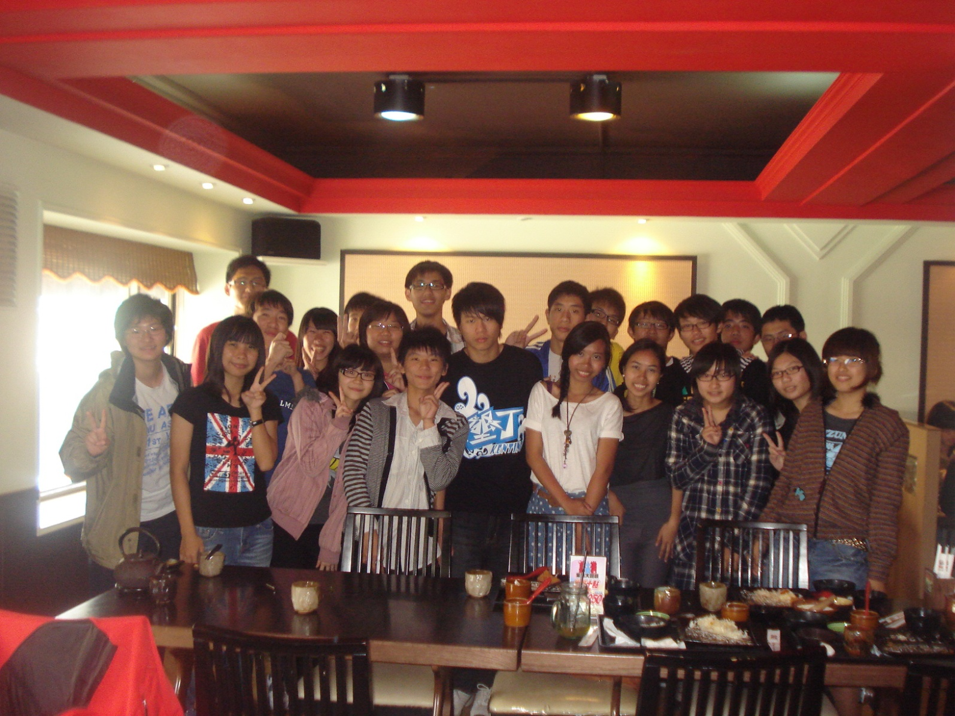
ESL Teachers with their students

Slide 34
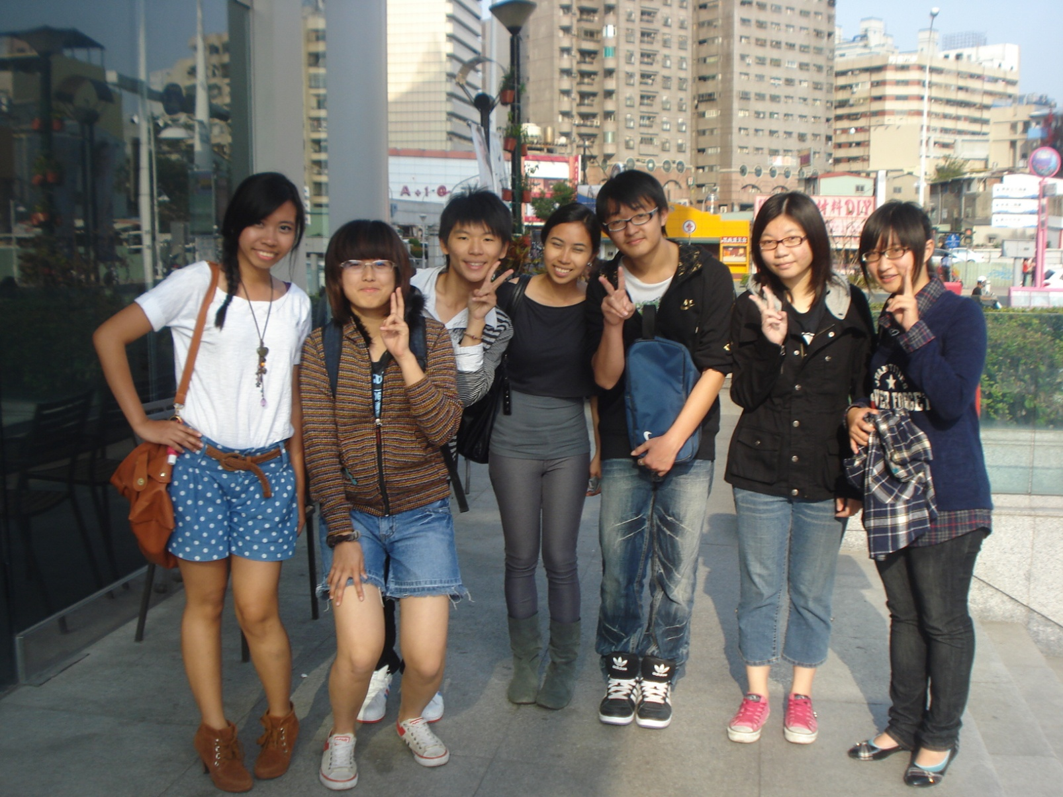
ESL Teachers and students

Slide 35
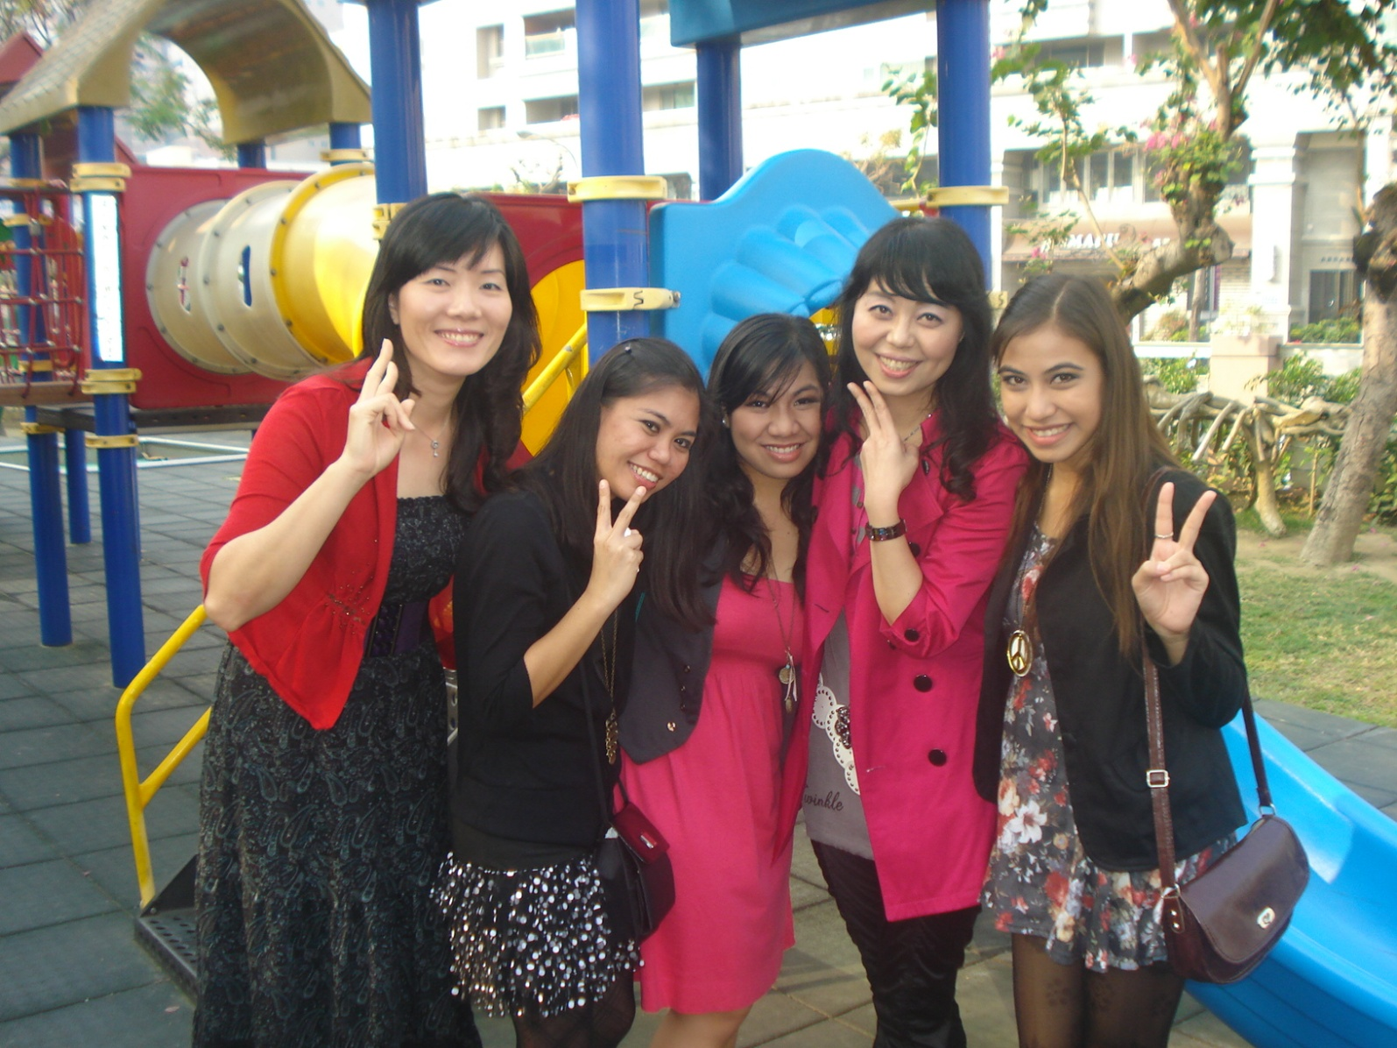
ECED with yu-cheng directors

Slide 36
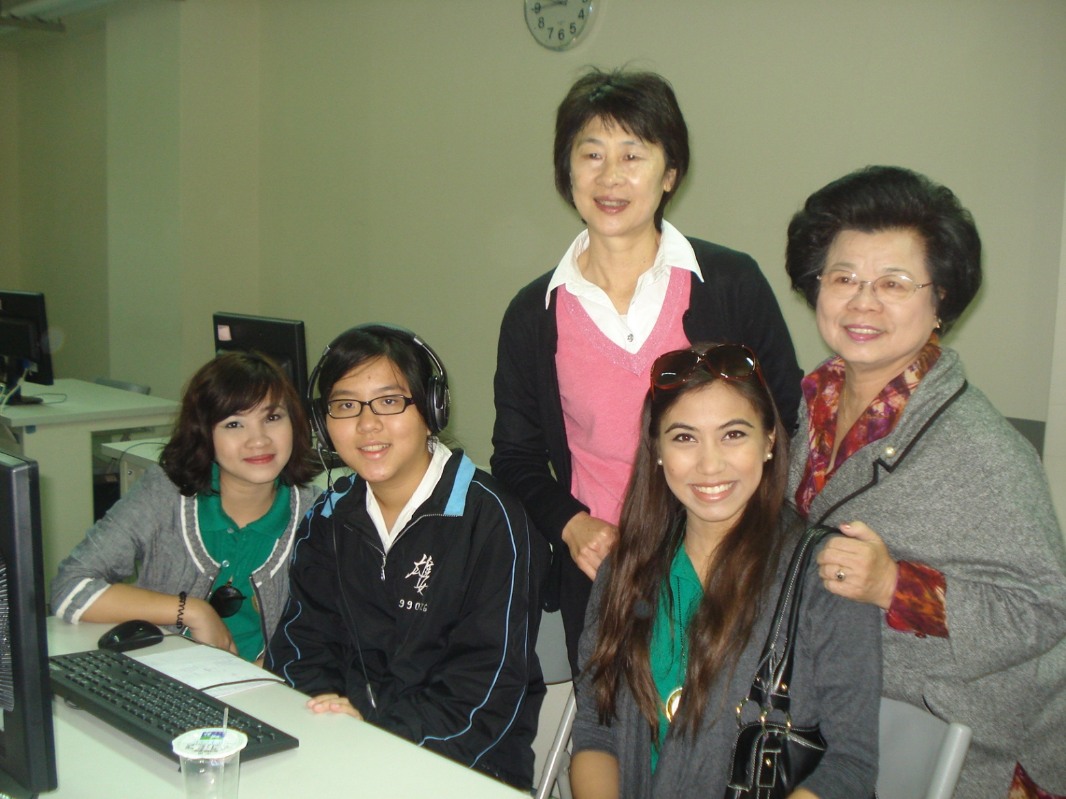
at Kaohsiung Municipal Girls Senior High

Slide 37
Observations
Fully equipped clinics, libraries, canteens, audiovisual centers, offices , gymnasium, playground, restrooms, Stationary Room, Teaching aids Room, Assembly Hall, Parent Teacher Room, Reception areas are all fully furnished
Supervised by competent leaders
Attended by thousands of students.

Slide 38
Characteristics of Teachers
know their students personally;
showed mastery of their subject matter;
were adjustable to the varied personalities of their students;
very good models/ facilitators for the students to obey, to interact with and to do their daily classroom activities;
friendly with their students;
showed personalized concern and attention specially to the kindergarten pupils;
All of the assigned cooperative mentors have finished their master’s degrees too. They are all regular teachers and tenured teachers.

Slide 39
Characteristics of Students
The kindergarten pupils, elementary and high school students are well disciplined;
kindergarten pupils are just wonderful, sweet, obedient, friendly, harmonious to be with, eager to learn and to be with their classmates;
The elementary pupils especially those with special needs are playful, carefree, but obedient, and well-disciplined too;
These special children were taught how to be responsible for themselves like: they have specific place to clean, how to clean like someone is mopping the floor while the other is wiping the shelves;

Slide 40
Characteristics of Students
All children experience nap period, because they stay in school the whole day.
Everyone is made to brush his teeth after eating .
Students with difficulty in academic subjects are pulled out from their regular classes to be given special attention by taking them to the “resource classroom“.
The teacher handles only 3-5 students per class depending on the child’s schedule and in 40 minutes in each subject. Because of their strategy, the children are able to learn more because of one on one teaching

Slide 41
Characteristics of Students
The regular classrooms have 25-30 students per classroom;
are given free healthy lunch consisted of rice, vegetables, fruits, soup and drinks.
After the meals, each child is made to wash his/her own plates and utensils for ready use the next day;
are given free mouth wash after brushing their teeth.
They are given thirty minutes to eat, wash their plates and brush their teeth, thus as early as this young age, they are made to manage their time efficiently.

Slide 42
Characteristics of High school Students
are well-disciplined, harmonious to deal with, curious, inquisitive, determined to listen, to learn and to initiate;
dealt with the student teachers with respect and at the same time are friendly;
are fun to be with, are happy, frank and solicitous of the student teachers’ knowledge and desires to know about Taiwan;
are acting as gentlemanly and lady- like adults at times during their lunch time and dismissal time.

Slide 43
Support of Parents
The parents pay a substantial amount to maintain the education of their children in public schools .
Presence of parents in the kindergarten and elementary schools;
are always around to fetch their children, some parents are also allowed to enter the classrooms to assist the teachers in supervising the children in selected activities.
One memorable experience by Carla de la Cruz was the fact that a parent gave a winter jacket to her so as to make her stay warm and comfortable. This parent gave this item thru the cooperative mentor which was gently received and later on returned during the last day in school.

Slide 44
Program of Instruction
The subject periods are well identified;
the school children know their respective schedules;
the class schedules for the week are varied into curricular, co-curricular and cultural activities;
The teachers have their own specializations which are properly appointed, scheduled, implemented, supervised and evaluated regularly. Regular meetings among the teachers with their directors are held for improvement.

Slide 45
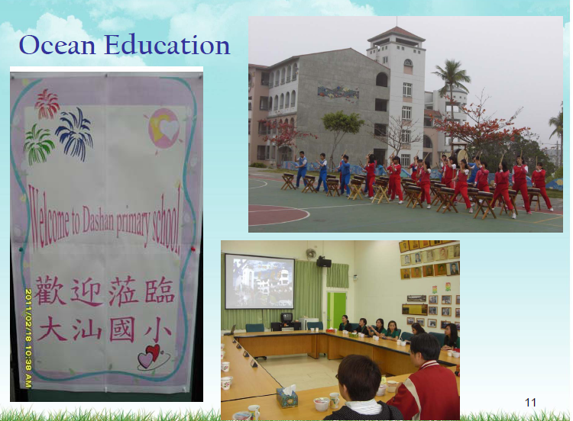

Slide 46
Electronic Education
pupils in the elementary and secondary levels were taught how to express their ideas, thoughts and feelings via surfing varied designs, creative works from their electronic notebooks;
made their projects / activities/ from the computer technologies like on the use of animations, sound effects, lines, shapes and colors, pictures and other resources.

Slide 47
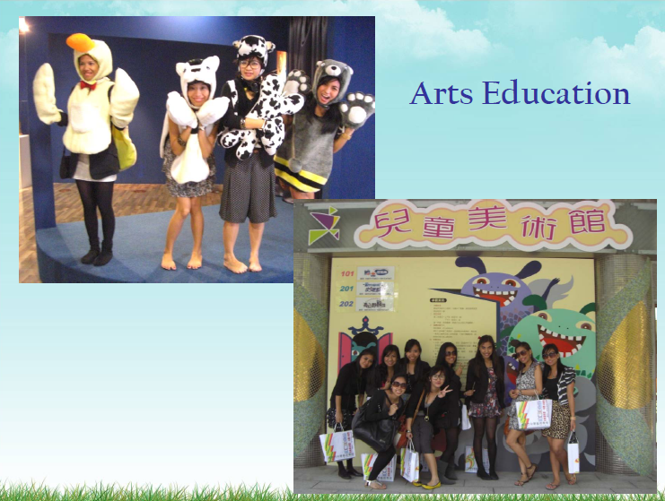

Slide 48
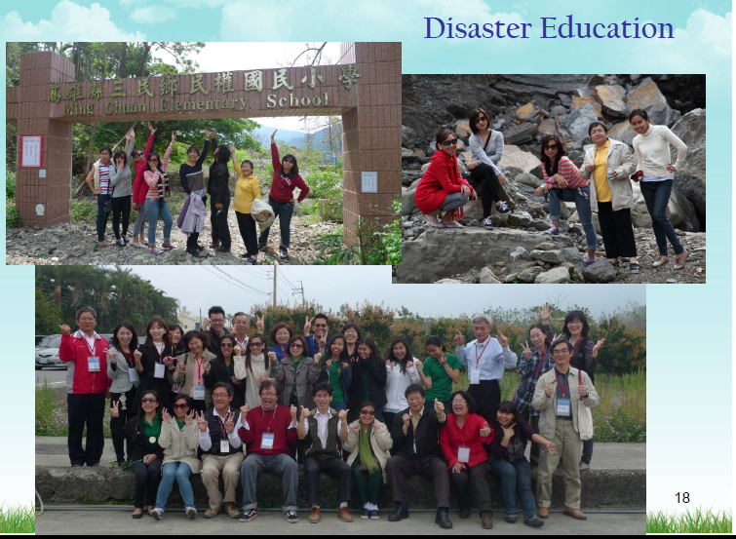

Slide 49
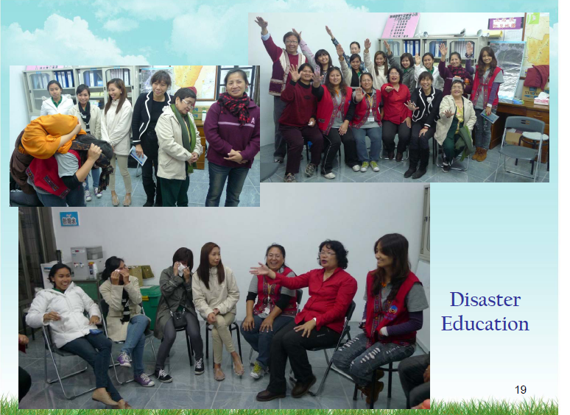

Slide 50
Methods, Approaches and
Strategies of Teaching - Learning:
There was versatility, diversity in the teaching methods, strategies of teaching learning:
The kindergarten and elementary schools used modeling, interactive and hands on activities.
Among the student centered activities were game shows, role playing, story telling, group story telling, playing a Filipino game, dancing and singing modern dance, showing of the Filipino flag and its identification of colors, modeling and demonstration.
The high school teachers employed mass media like newspapers, television programs, movie series, discovering what they learned, sharing sessions, imaging via drawing, poster making, role playing and discussion sessions in groups. The teacher used the reward system to encourage the students’ maximum involvement.

Slide 51
Preparation of
Instructional Materials/Aids
The student teachers were not given the opportunity to prepare any instructional materials
All the materials were prepared, stored in the stock room for ready use
Each classroom in fact has many books, educational toys, visual aids to be used.

Slide 52
Integration of Values
The student teachers demonstrated the integration of values by showing good relationship with the pupils, students and teachers,
Being available to assist them to do their assigned tasks,
giving positive feedback of their performances,
giving them a hug for the kinder of their achievements and giving them assurances for the good things they did in the classroom.
Dealing with their students as persons with feelings, in need for acceptance, belongingness, recognition for their achievement, feeling of worth as well as being friendly and available for them.
The student teachers likewise felt as partners of the professional teachers in the classroom.

Slide 53
Assessment of Learning Experiences
The student teachers experienced administering a pen and paper test in Mandarin, but they could hardly understand;
They saw how creative the students were in their drawings, slogans, objects, and behaviors expected of them as responsible children in the classroom.
Moreover, the high school students were observed to have manifested their great interest to speak, and to write in the English language via their inquiries, sharing of experiences, creating their slogans, poster and in writing their essays.

Slide 54
To what extent have the student teachers manifested their behaviors in the classrooms and school community during their stay with the cooperating mentors ?
The following tables will show how the nine student teachers rated themselves as well as the cooperating mentors rated their assigned student teachers. A scale of 1 as the lowest and 10 as the highest in each of the following behavioral traits was administered to the nine student teachers and the nine cooperating mentors to rate.

Slide 55
Table 1
Students’ Self -Rated (SSR)Behavioral Traits and Mentors’Observed Behaviors (MOB) on the Student Teachers

Slide 56
Students’ Self Rating (SSR) & Mentors’ Observed Behaviors (MOB)
 | SSR | MOB
a)Showed determination to learn . | 10 | 10
b)Accepted tasks readily as a teacher. | 10 | 10
c) Did assigned tasks with joy. | 10 | 10
d) Assumed daily responsibility enthusiastically . | 9.5 | 10
e) Initiated activities/ideas with /for the group. | 9.0 | 9.0
f) Shared concern for the pupils’ behavior in learning. | 8.0 | 8.0

Slide 57
Students Self Rating(SSR) Mentors” Observed Behaviors (MOB)
 | SSR | MOB
g) Manifested personal values that are important for children | 9.0 | 8.0
h) Showed passion in teaching to carry professional self. | 9.0 | 10.0
Accepted instruction humbly. | 10.0 | 10.0
j) Accepted mistakes honestly. | 10.0 | 9.0
k) Exuded self-confidence in being a teacher. | 9.0 | 9.0
l) Acted as a good model teacher. | 9.0 | 9.0
m) Shared insights and learning experiences | 9.0 | 9.0

Slide 58
Students’ Self Rating (SSR) Mentors’ Observed Behaviors (MOB)
Multiple Intelligences | SSR | MOB
Demonstrated bodily – Kinesthetic intelligence in delivering the lessons. | 10.0 | 10.0
Demonstrated oral linguistic intelligence in facilitating the lessons. | 7.0 | 7.0
Demonstrated drawing or artistic intelligence in preparing the visual aids | 7.0 | 8.0

Slide 59
Students’Self Rating (SSR)and Mentors’ Observed Behaviors (MOB)
 | SSR | MOB
Demonstrated musical intelligence in the teaching – learning sessions. | 10.0 | 10.0
Demonstrated teamwork | 9.5 | 9.0
Showed gratitude to persons who assisted her. | 10.0 | 9.0
Demonstrated love for nature as shown in her visuals. | 9.0 | 9.0
Demonstrated intelligently written lesson plans. | 9.0 | 9.0

Slide 60
ANALYSIS
above-mentioned data show that the student teachers have demonstrated the highest degree of their interpersonal relationship with their teachers and pupils.
This implies that foremost in their minds was the fact that their harmonious personal contact with the teachers and pupils is indeed very essential to maximize their determination to improve themselves from all their learning experiences in Taiwan.
Their openness and acceptance to the varied tasks of a teacher for exposure to all the factors of their learning environment, awareness of the important values that the children caught and taught,

Slide 61
ANALYSIS
coupled with their spontaneity to share their insights through their pre-and post conferences, submission of daily journals;
the use of their energetic body language made them feel as para-professionals too, therefore are grateful to their cooperating teachers;
It could also be noticed that the student teachers manifested a great degree of self confidence because of the fact that the cooperating teachers have accepted them as co-workers in the classroom;

Slide 62
ANALYSIS
to do their assigned tasks, to accept instruction, to assist the cooperating teachers enthusiastically in the daily routines, their new tasks for the children as well as accepted some initiatives coming from them as partners too.
Six out of nine student teachers scored highest in demonstrating teamwork, manifesting linguistic, spatial, passion for teaching in caring their professional selves and

Slide 63
ANALYSIS
good modeling for a teacher means that the student teachers found it very healthy to assume their varied tasks because they have received positive attitudes and outlook from their teachers and pupils;
while nine again demonstrated their musical intelligence and regular sense of responsibility.

Slide 64
ANALYSIS
It was significantly observed that a good number of them scored 5-8 in coming to classes punctually which may be taken to mean that the student teachers were sometimes late for their assigned tasks. Was it because seven of them had to commute via the train to reach their destination or because of their lack for excellent time management was wanting?
Over all the student teachers‘ self assessment may be taken to mean that they have demonstrated a high degree of performing the traits and behaviors of beginning global teachers;

Slide 65
ANALYSIS
that they should strive to manifest these behaviors and traits to the higher degree if not to the highest degree. That the student teachers’ time management could be improved.

Slide 66
ANALYSIS
It could be gleaned that the cooperating teachers rated the student teachers very highly from a perfect score of ten to a score of eight which is still considered above average in almost all the twenty one traits.
This may be taken to mean that these cooperating teachers must have observed a great deal of manifestation of these twenty one traits and behaviors from among the student teachers.

Slide 67
ANALYSIS
The fact that these professional cooperating teachers have very high academic preparation, are tenured and are master teachers assigned to the student teachers imply that they surely have concrete basis of their observations on their student teachers under them.
Generally, all of these observed traits and behaviors of the student teachers as beginning global teachers are very much worthy to cherish about the student teachers.

Slide 68
Conclusions
From the data presented, the following conclusions are deduced:
The World Council for Curriculum and Instruction International Collaborative Research on the Partnership between the Global City Innovative College of Taguig City, Philippines and the National Kaohsiung Normal University of Kaohsiung, Taiwan on One Month Practice Teaching Program to Assist in the Formation of Future Global Teachers was well conceptualized, excellently coordinated for implementation and objectively evaluated by both Dr. Teresita P. Pedrajas of the GCIC and Dr. Vincent Sheih of the National Kaohsiung Normal University .

Slide 69
Conclusions
Various stages on the approval of the research proposal started by submitting the idea and the whole strategic plans to Dr. Carolina Danao, the GCIC Vice President for Academic Affairs, who likewise endorsed to the GCIC President, Engr. Michael Tan for approval;
presented the matter to the thirteen graduating students,

Slide 70
Conclusions
  conducted a conference with their parents for support and cooperation on the program, objectives, expectations, finances, security, board and lodging, activities and collaboration with the NKNU;
      the production of requirements for the passport and Taiwan visa; getting of the airplane tickets, schedule of activities and the City of Kaohsiung, Taiwan .

Slide 71
Conclusions
That the National Kaohsiung Normal University provided excellent learning experiences to the nine student teachers from the Global City Innovative College to:
develop self confidence,
oral and written communication in English,
ability to prepare challenging lesson plans,
deliver lesson interestingly with a variety of student centered activities,

Slide 72
Conclusions
demonstrate their multiple intelligence as linguistic, bodily-kinesthetic, musical, interpersonal, intra personal, logico-mathematical, naturalistic;
plan the use of instructional materials,
integrate values and to make classroom evaluation instruments.

Slide 73
Conclusions
Moreover, the student teachers have
manifested their competency-based skills like decision making, time management, budgeting their allowance, negotiating, relating skills, cooperating and teaching skills.
The NKNU exposed student teachers to the rich and best Taiwanese culture from day one to -day thirty.

Slide 74
Conclusions
The dynamic leadership and intensive supervision of Dr. Vincent Shieh, Dr. Victor Fang of the World Council for Curriculum and Instruction International via the Taiwan National Chapter made this project successful.

Slide 75
Conclusions
The GCIC student teachers experienced the rich culture of Taiwan in terms of persons in the schools, leaders in the Education Bureau, the highly prioritized \educational system which are supported by the government and the parents,
the highly paid teachers,

Slide 76
Conclusions
            the technologically oriented and friendly school campuses,
the disciplined people, the well maintained cultural museums, buildings, structures, rivers, arts, business sectors,
the modern and well maintained, safe transportation facilities like train, buses, highways and taxi cabs,
the well maintained streets, light posts, street signs, traffic lights,
the adequately supervised recreational, spiritual and cultural and business centers,

Slide 77
Conclusions
the fresh, nutritious food which were beautifully and attractively cooked, presented and sold,
the fond for eating and cooking among the people,

Slide 78
Conclusions
the intensive collaboration among the non-governmental and governmental sectors to assist their brothers and sisters who were survivors to national calamities,
no sight of street beggars or neglected children or families,
thus met and observed the people who are happy, satisfied, and peaceful.
All of these are indicators of very good leadership and governance of Kaohsiung, Taiwan.

Slide 79
Recommendations:
                This model for networking partnership is hereby recommended for replication in other countries.
That the WCCI International gives Citation of Distinction to the NKNU and the GCIC for the partnership be done.
That future projects may also be allotted a minimal budget for essential expenses on administration and paper work.

Slide 80
Recommendations:
A crash program on studying the Mandarin language will enable the future student teachers more teaching time with the Taiwanese students in the kindergarten and elementary schools for better and efficient communication without the Taiwanese teachers translating the English into Mandarin anymore; and or maybe the Filipino students could have been more exposed to teaching English as a second language for the children.

Slide 81
Recommendations:
Taiwan has a very rich and beautiful culture to enrich, to inspire and to engage every global educator.
The results of this study should be shared with the WCCI National and International Conferences or fora for better information and collaboration among its members.

Slide 82
Thank You
and
MABUHAY!!!

